Slide 1
Helping Hand By Bhanvi
SUBMITTED TO:- PROJECT INCHARGE
SUBMITTED BY:- BHANVI
87185102

Slide 2

CLOUD COMPUTING
Cloud computing is the delivery of different services through the Internet. These resources include tools and applications like data storage, servers, databases, networking, and software.
Rather than keeping files on a proprietary hard drive or local storage device, cloud-based storage makes it possible to save them to a remote database. As long as an electronic device has access to the web, it has access to the data and the software programs to run it.
Cloud computing is a popular option for people and businesses for a number of reasons including cost savings, increased productivity, speed and efficiency, performance, and security.
Cloud computing is named as such because the information being accessed is found remotely in the cloud or a virtual space. Companies that provide cloud services enable users to store files and applications on remote servers and then access all the data via the Internet. This means the user is not required to be in a specific place to gain access to it, allowing the user to work remotely.

Slide 3
Cont.
Cloud computing takes all the heavy lifting involved in crunching and processing data away from the device you carry around or sit and work at. It also moves all of that work to huge computer clusters far away in cyberspace. The Internet becomes the cloud, and voilà—your data, work, and applications are available from any device with which you can connect to the Internet, anywhere in the world.
Cloud computing can be both public and private. Public cloud services provide their services over the Internet for a fee. Private cloud services, on the other hand, only provide services to a certain number of people. These services are a system of networks that supply hosted services. There is also a hybrid option, which combines elements of both the public and private services.

Slide 4
Types Of Cloud Services
Regardless of the kind of service, cloud computing services provide users with a series of functions including:
Email
Storage, backup, and data retrieval
Creating and testing apps
Analyzing data
Audio and video streaming
Delivering software on demand
Cloud computing is still a fairly new service but is being used by a number of different organizations from big corporations to small businesses, nonprofits to government agencies, and even individual consumers.

Slide 5
Types Of Cloud Computing
Cloud computing is not a single piece of technology like a microchip or a cellphone. Rather, it's a system primarily comprised of three services: software-as-a-service (SaaS), infrastructure-as-a-service (IaaS), and platform-as-a-service (PaaS).
Software-as-a-service (SaaS) involves the licensure of a software application to customers. Licenses are typically provided through a pay-as-you-go model or on-demand. This type of system can be found in Microsoft Office's 365, dropbox.
Infrastructure-as-a-service (IaaS) involves a method for delivering everything from operating systems to servers and storage through IP-based connectivity as part of an on-demand service. Clients can avoid the need to purchase software or servers, and instead procure these resources in an outsourced, on-demand service. Popular examples of the IaaS system include IBM Cloud and Microsoft Azure,AWS EC2.
Platform-as-a-service (PaaS) is considered the most complex of the three layers of cloud-based computing. PaaS shares some similarities with SaaS, the primary difference being that instead of delivering software online, it is actually a platform for creating software that is delivered via the Internet. This model includes platforms like Salesforce.com and Heroku,IBM cloud.

Slide 6
INTRODUCTION
Helping Hand By Bhanvi is a Recommendation System For the targeted users. It will Target a Group of people such as teenagers or travelers and people who need recommendations for their next step. The system I made is general purpose but we can extend it into a lot of things i.e lots of recommendation system can be included into this project. This idea was taken from amazon and Netflix etc’s Recommendation engine. Both of these sites use user recommendation to increase the user experience. My system will take input from the users and will tell them what shall be helpful or useful for them after watching or using a particular thing. This System will be helpful for clarifying the user’s Confusion. As

Slide 7
Cont.
nowadays in this busy life everyone has not much time to think for each and every small things, that’s why we develop a system so that it will not burden user to think , user will just enjoy the services. We can use this system separately and also can embed this with different types of systems. In this project basically i want to show my cloud computing and management skills of various types of data. Here we first start from building algorithm for recommendations for that I have used cosine method with letters. After successful completion of python side work I started working on it’s frontend for user interface. After frontend development I’ve built connection between HTMl and python files then I built a server of that on AWS cloud and built a interactive Recommendation System. A step by step guide of my project is given in further sub-topics.

Slide 8
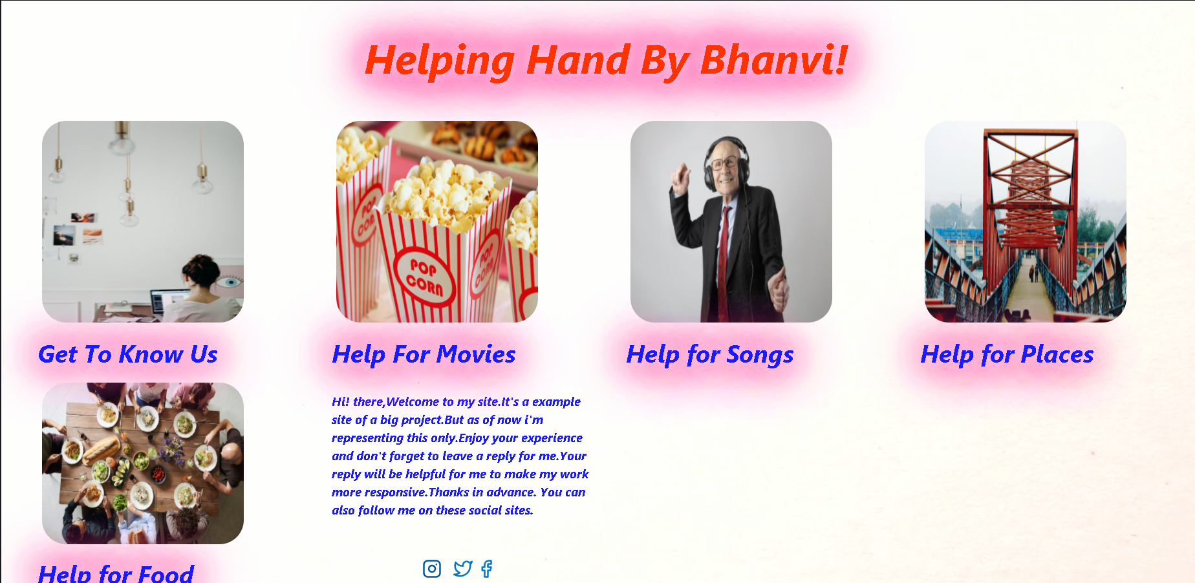

Slide 9
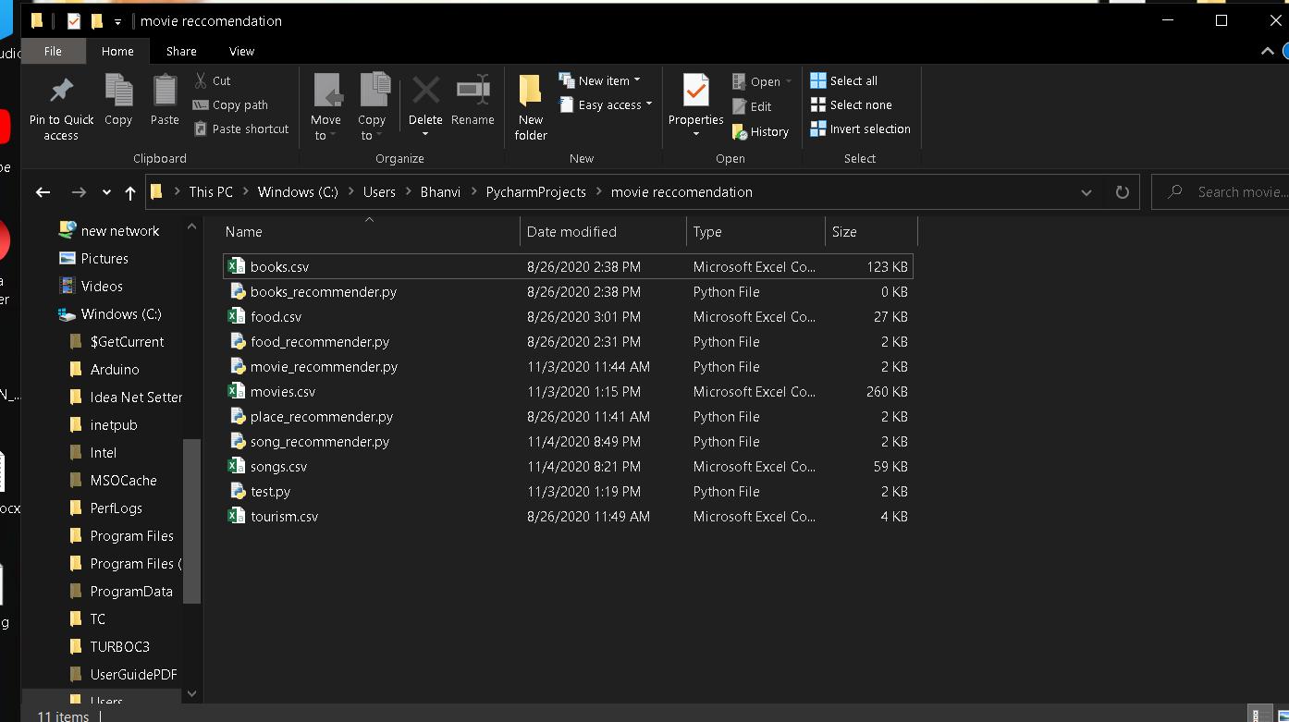
Complete guide to the Project
Python Phase
To get started let’s make a new folder named Recommendation system and open it. Crate a text file inside it named “Movie.py”.

Slide 10
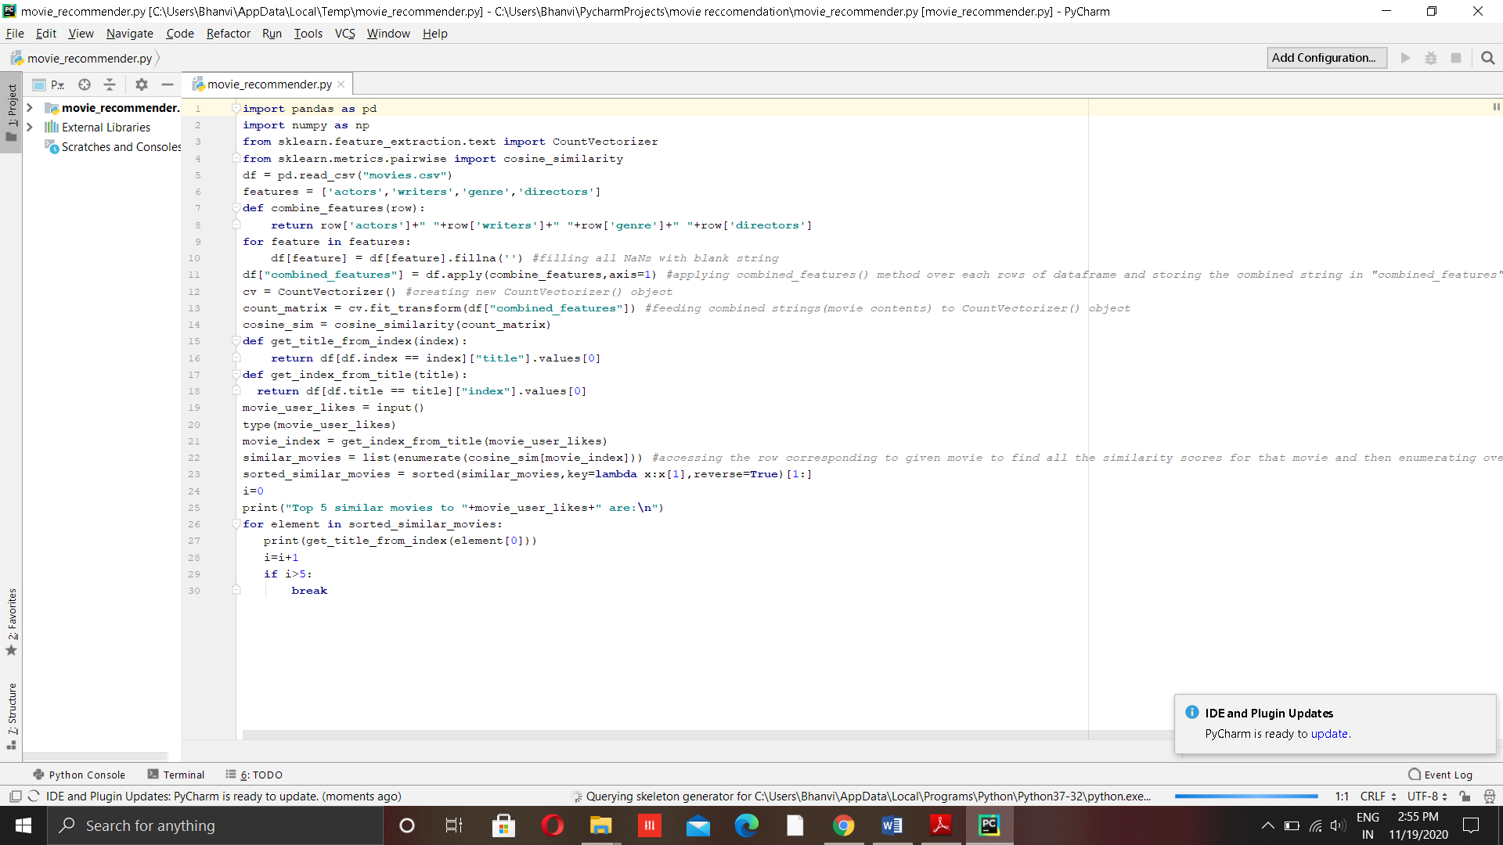
Cont.
It will create a python file and now you can add your data science code to it and can attach database to python file for further predictions. After coding our page will look like this:-

Slide 11
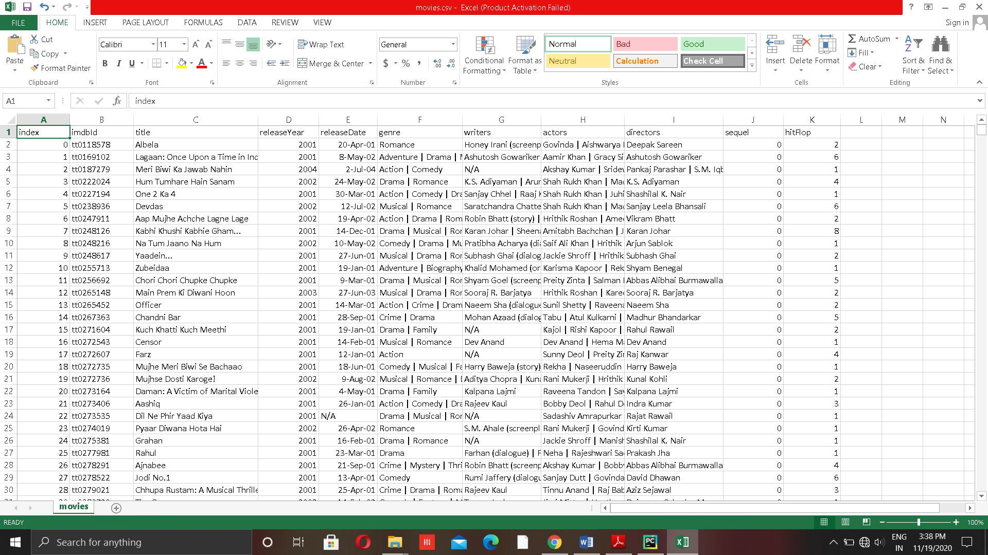
Cont.
After making File for one prediction system you can create multiple with datasets and make same predictions for this. For example Recommendation of Songs , Food , Places etc. I have add some of these features to my project using suitable data set for each other as you can see in fig 8.1 (Files Description). Example dataset for movies is shown below:-

Slide 12
Cont.
After adding these datasets and running the python program efficiently we will make a simple user interface for the system.
User Interface
To create user interface for each page we are using HTML and CSS here. It is a simple GUI To interact With user. My main purpose of making this project is to show my Data science and Cloud Skills. Here I have given serial wise entry of my html pages and a brief introduction of all the pages. How they will attach to each other and their working. My First Page shows you little introduction of my Project:-

Slide 13

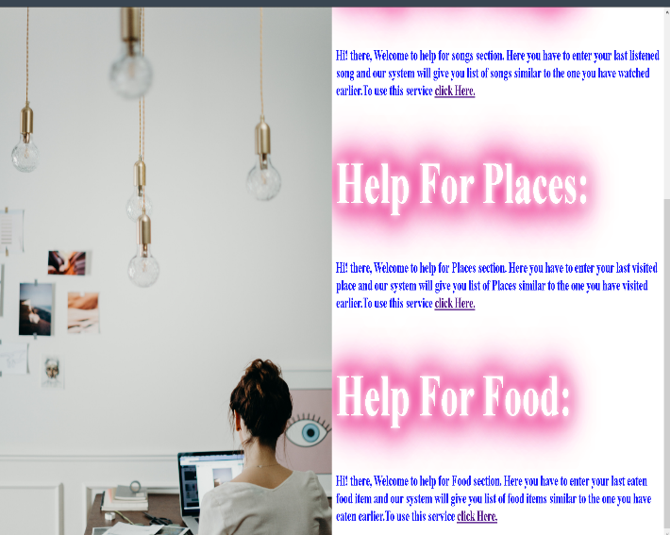
Cont.
This introductory page gives link to further pages i.e first one which is “Get to Know us” will tell about the use of each pages. Next tab i.e “Help For Movies” will go to the movies recommendation page and so on pages. Here is the figure for “Get To know us” page:-

Slide 14
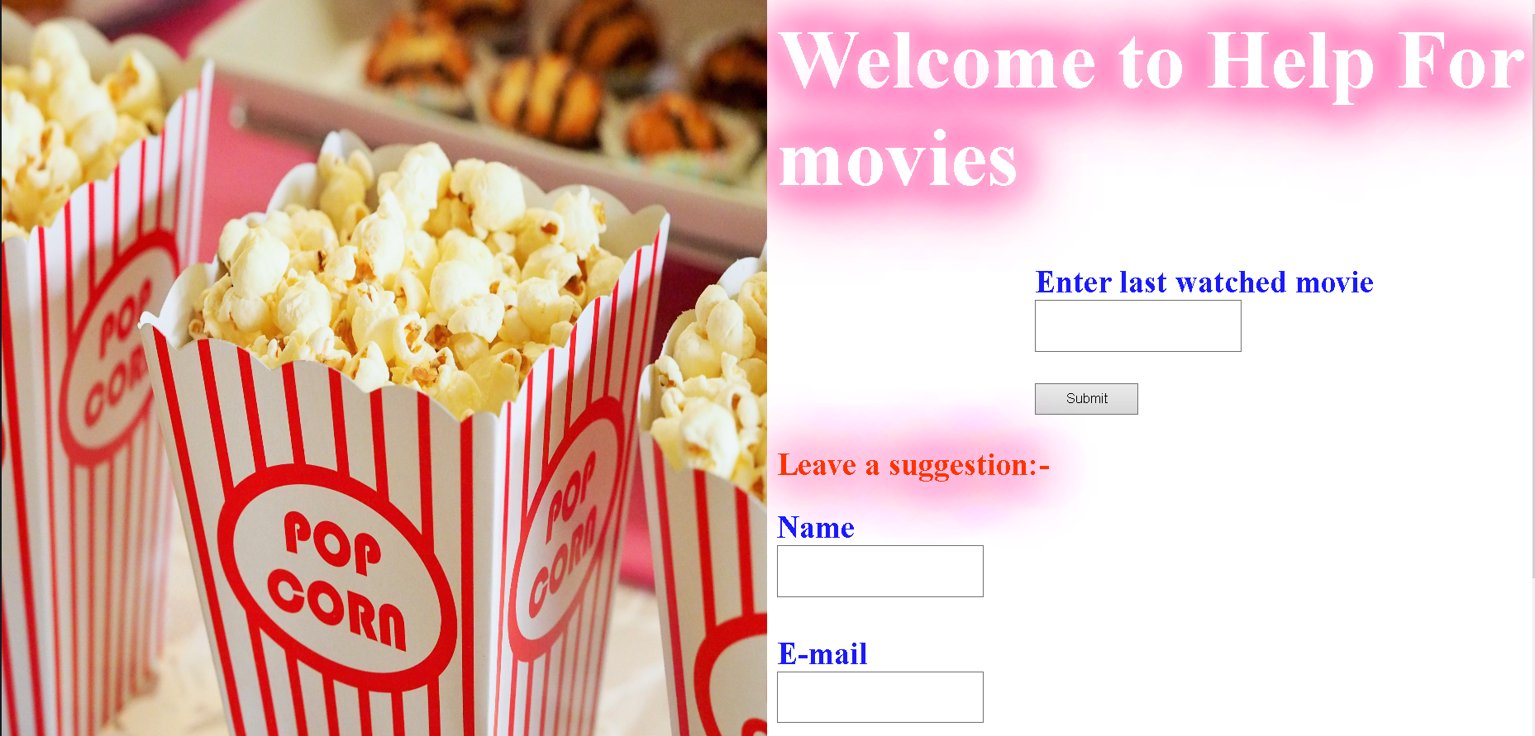
Cnot.
This page contains links to all other pages of the site i.e Help for movies, Help for songs, Help for places and Help For Food. It will Also Give you introduction about all pages.
Next Page in my site is help for movies. Here is figure for it:-

Slide 15
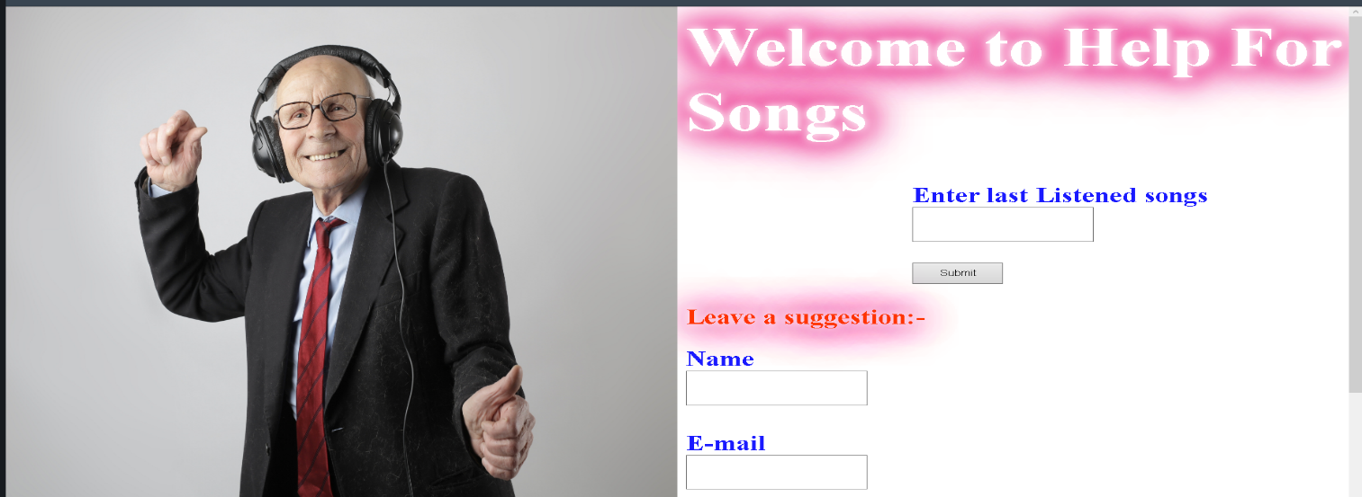
Cont.
Here you have to enter the last movie you have watched and my system Will provide you with a list of movies similar to the one you have watched. After giving the movie name user have to click on submit button to get the results. Here I have also given a feedback form which is directly connected to the cloud in this feedback form user will enter their feedback and they will be store to the cloud in the form of a database.
Figure for next page is shpwn below:-

Slide 16
Cont.
Like the previous page here also you have to enter previously listened song and system will give you similar songs which you can listen further. This type of functionality is also in spotify and amazon music but I have used cosine similarity to extract similar songs from the datasets. In this page also, I have given a feedback form for the user. As stated earlier you can embed these algorithm with other services and can also add more services to the webpage.
Here is the figure for another sevice:-

Slide 17
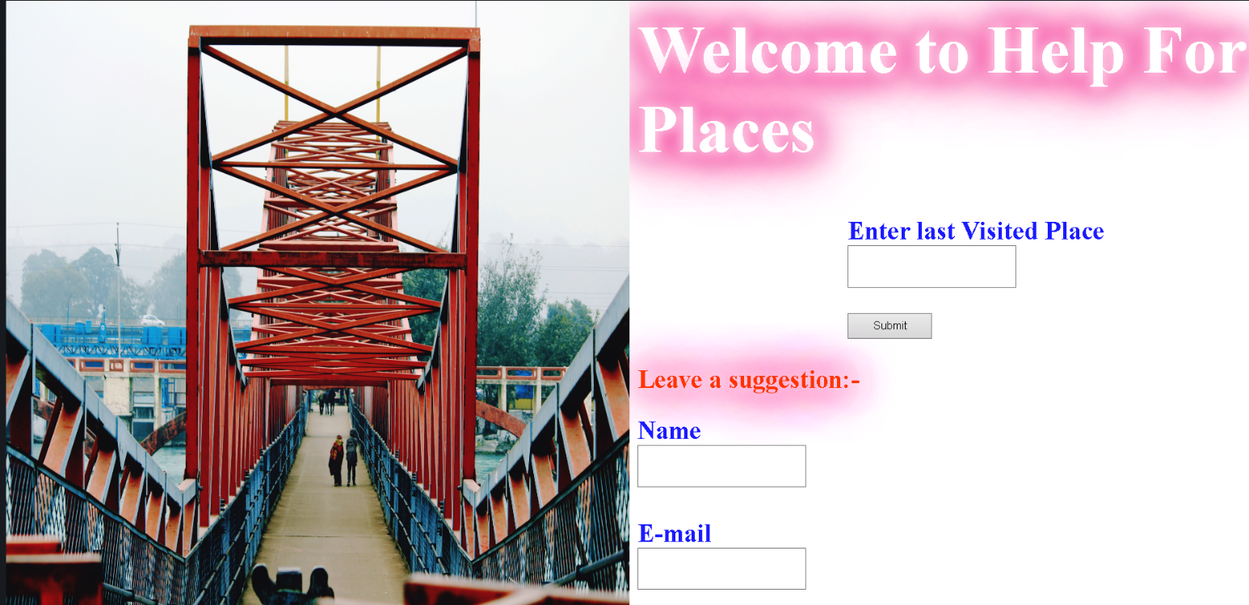
Like the previous page here also you have to enter previously Visited place and system will give you similar places which you can visit further. This type of functionality is also in Google Maps but I have used cosine similarity to extract similar Places from the datasets. In this page also, I have given a feedback form for the user. As stated earlier you can embed these algorithm with other services and can also add more services to the webpage.
Here is the figure for another sevice:-

Slide 18
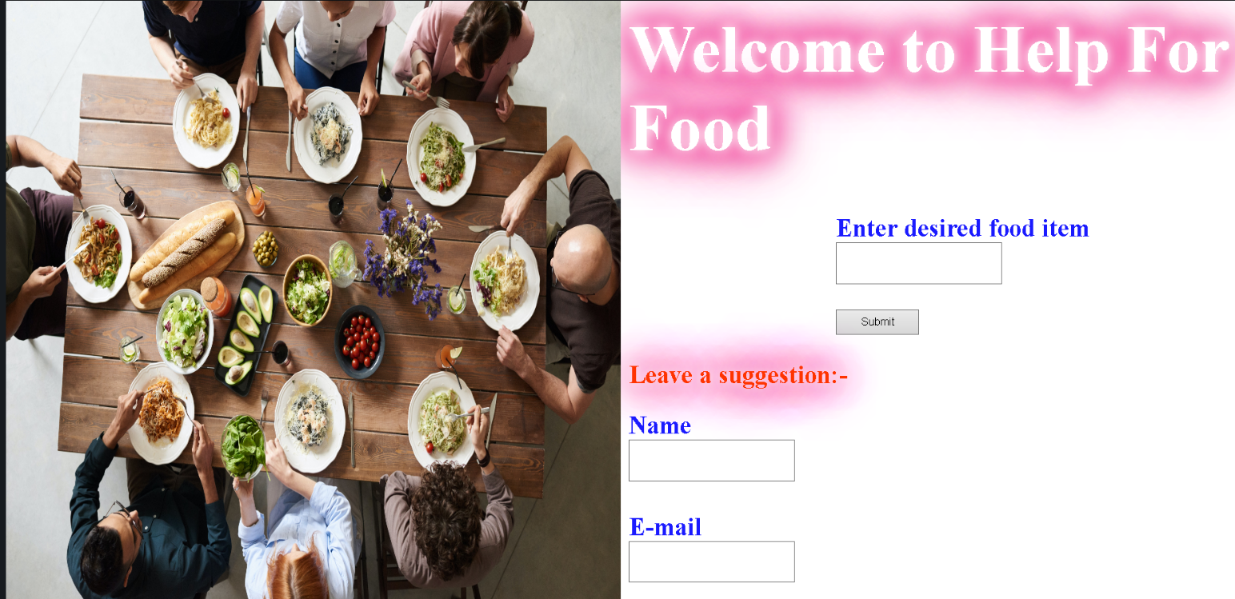
Cont.
Like the previous page here also you have to enter previously eaten food and system will give you similar Food which you can eat further. This type of functionality is also in Hotels and Restaurants for better user experience but I have used cosine similarity to extract similar Places from the datasets. In this page also, I have given a feedback form for the user. As stated earlier you can embed these algorithm with other services and can also add more services to the webpage.
That’s all for the user interface next we will go to the connectivity of GUI and Python File This can be done using DJnago. For this purpose we have to create a separate backend file for HTTP and for other Protocols

Slide 19
Cont.
For this purpose we will make separate python file for separate services as we are not making our project at so high level that’s why we have to make different files for different phases. After Connectivity of python file we will male cloud infrastructure for our project.
Cloud Infrastructure
We are using AWS Cloud for this purpose. For this on google you have to type AWS and you will get first link for official website of AWS (Amazon Web services)

Slide 20
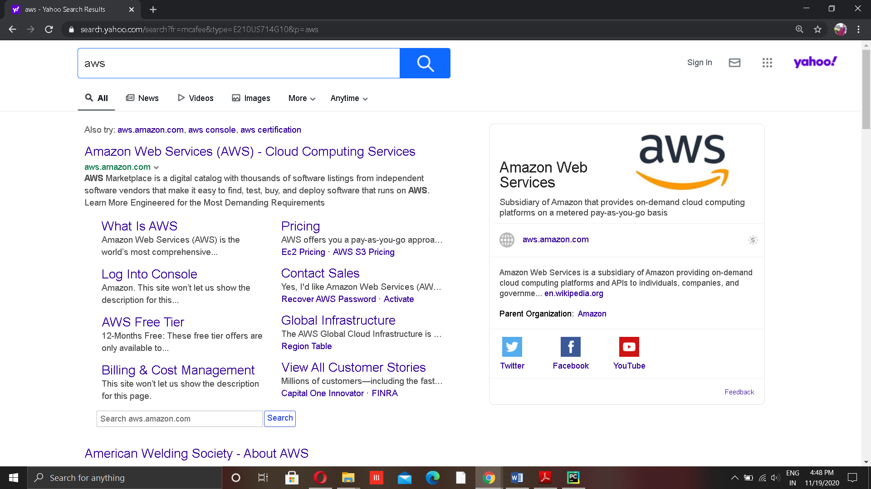
Click on the first link which will take you to the Official site of amazon web services. There are lots of services provide by the AWS ,some of which we’ll be using in our project.Here shows the main page of AWs after Login to their console:-

Slide 21
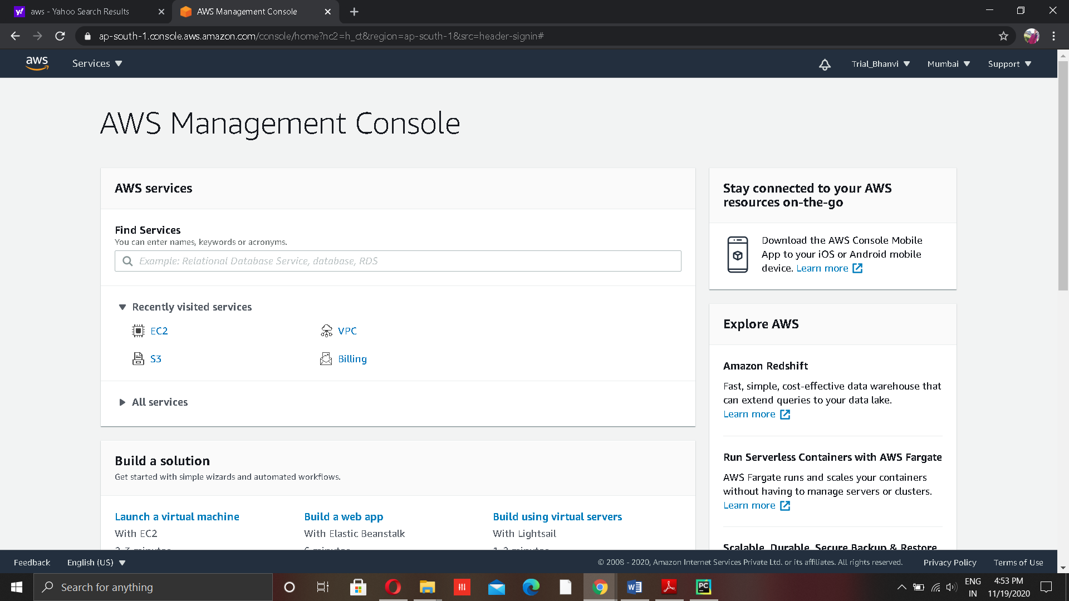
This is the front page for your amazon management console here you can get all the services you have used in past and can get billing of your services used. From this page you can start using other different services by clicking on the services dropdown menu. As Shown in fig:-

Slide 22
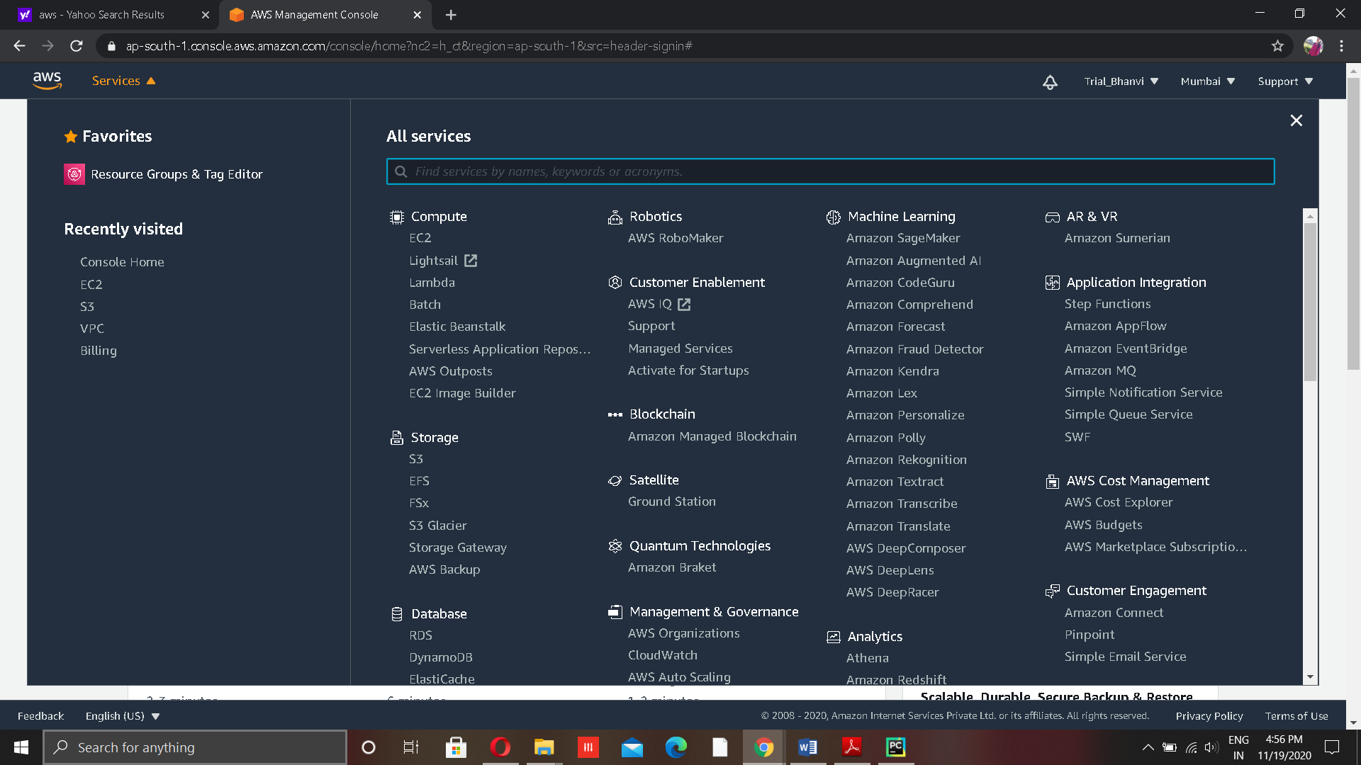
Here is the list of a lot services that are provide by the AWS . You can choose any of the services according to your needs and your requirements , that you want to add on to your project. By using AWs you can even create a whole infrastructure of your company and can even hire just a single software from there. The billing of the services is on the basis of pay as you go i.e you have to pay for the services only which you are interested in or which you have used.
As of now we need just storage services and database service for our project as it doesn’t need server side configuration but for instance we are doing it using both steps that is using storage and by server configuration also .
By using storage service you just make sure that your project is running efficiently on your local machine. The process of hosting your site using storage services like S3 is known as Static Hosting of website. This is called static because there is no need of server side configuration and no backend processing is there.

Slide 23
Cont.
Code just need to be run on the internet so publicly S3 which is also called object storage will be used. After you host your site on S3 you will get a link which will help you to run your site on internet.
To run site on server side first you have to make server for this, using EC2 service of AWS which is use to make a whole other system which will work for you 24/7. The server is generally linux based so for this you have to be properly knowledgeable about the linux Os . There is different tutorial for how to establish your project on EC2 . For this project I have create a simple server and add on my HTMl and CSS files to the server and AWS have provided me a link to my project which is running on server side. Hence I have shown my server side skills using this project. I will share link to my project in the index page of this project report.

Slide 24
THANKS !

